Slide 1

Sprint - 2
Rajan Kumar
29/08/2024

Slide 2

Coordinate systems
Cartesian coordinate system
Each point in the system is represented by a triplet (x, y, z) in 3D, where:
x: The distance along the x-axis.
y: The distance along the y-axis.
z: The distance along the z-axis.
It can be either left hand or right hand coordinate system.

Slide 3
2. Right hand coordinate system
In a 3D right-handed system, the x-axis, y-axis, and z-axis are arranged such that if you curl the fingers of your right hand from the x-axis to the y-axis, your thumb points in the direction of the z-axis.
Cross product
The coordinate system follows conventional mathematical transformations such as rotation matrices that preserve the orientation defined by the right-hand rule.

Slide 4
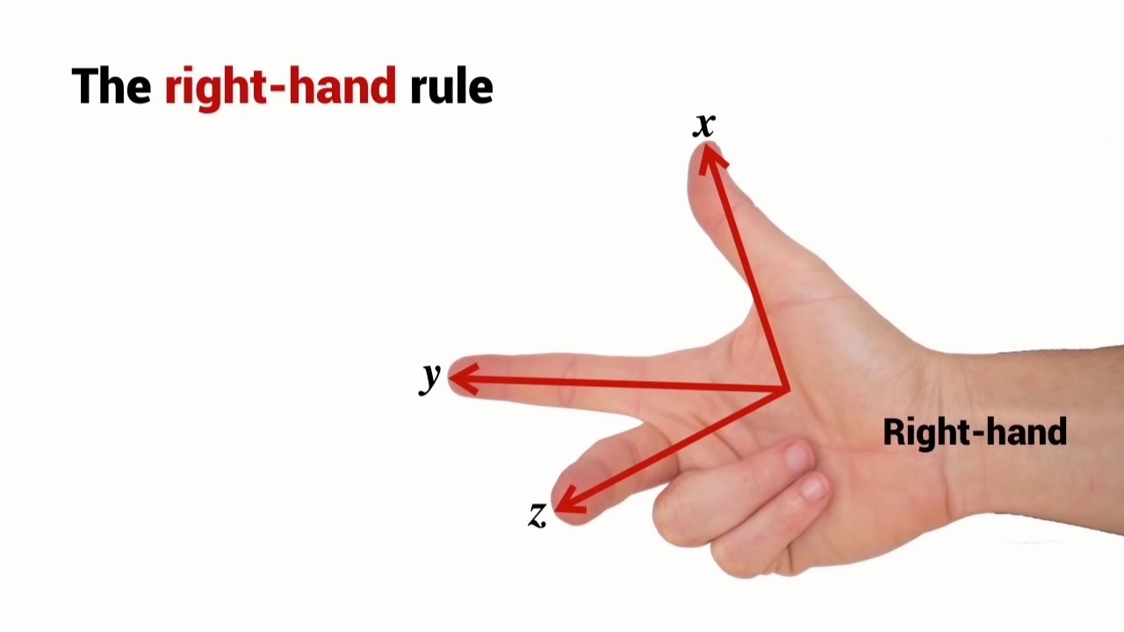

Slide 5
3. Left hand coordinate system
In a 3D left-handed system, the x-axis, y-axis, and z-axis are arranged such that if you curl the fingers of your left hand from the x-axis to the y-axis, your thumb points in the direction of the z-axis.
Cross product
Transformation matrices differ in terms of signs compared to right-handed systems due to the orientation differences.

Slide 6
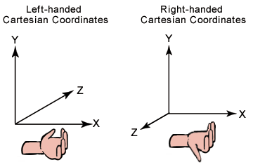

Slide 7
4. Cylindrical coordinate system
The cylindrical coordinate system is a three-dimensional coordinate system that extends polar coordinates by adding a height component along the z-axis.
A point in the cylindrical coordinate system is represented by (𝑟,𝜃,𝑧), where:
r: radial distance from origin
𝜃: The angular coordinate, the angle between the positive x-axis and the line from the origin to the point’s projection in the xy-plane.
Z: The height or vertical distance from the xy-plane to the point.

Slide 8
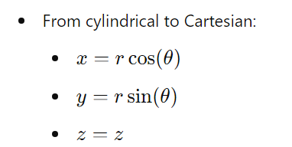
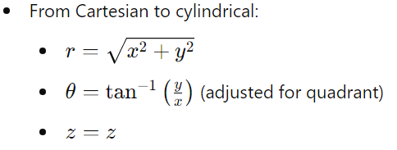
From cylindrical to Cartesian:

Slide 9
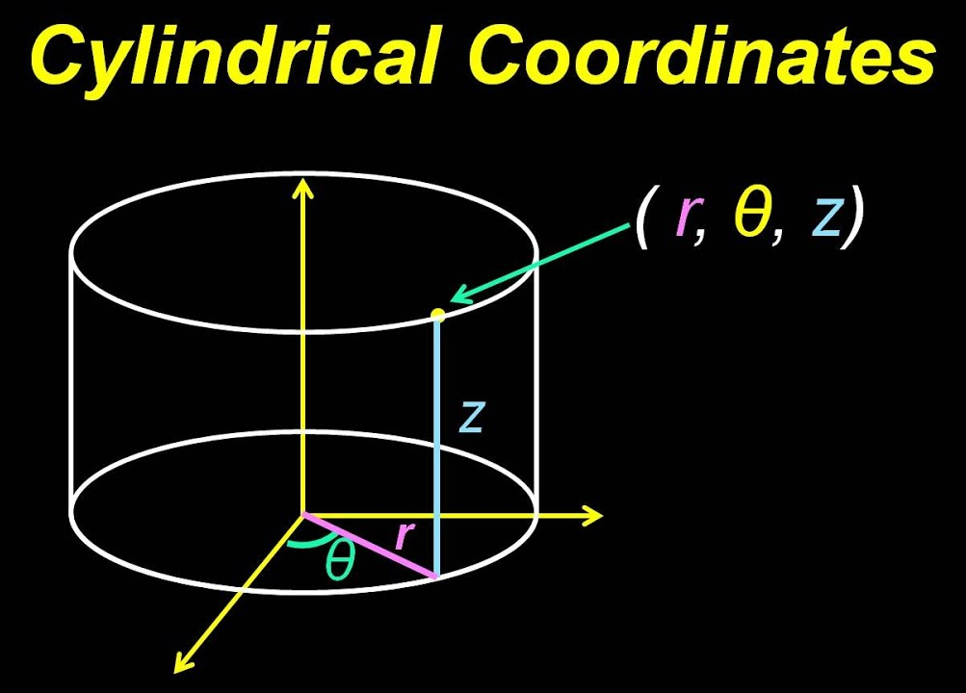

Slide 10
5. Spherical coordinate system
The spherical coordinate system is a three-dimensional coordinate system that describes a point in space using three values: the radial distance, the polar angle, and the azimuthal angle.
A point in the spherical coordinate system is represented by (𝑟,𝜃,𝜙), where:
r : The distance from the origin to the point.
Θ (polar angle): The angle between the point and the positive z-axis. (0 to 𝜋 radians)
ϕ (azimuthal angle): The angle between the projection of the point onto the xy-plane and the positive x-axis. (0 to 2𝜋 radians)

Slide 11
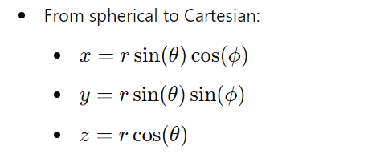
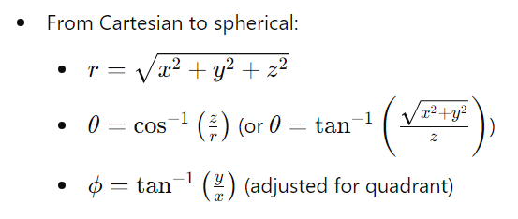
Conversion of coordinates.

Slide 12
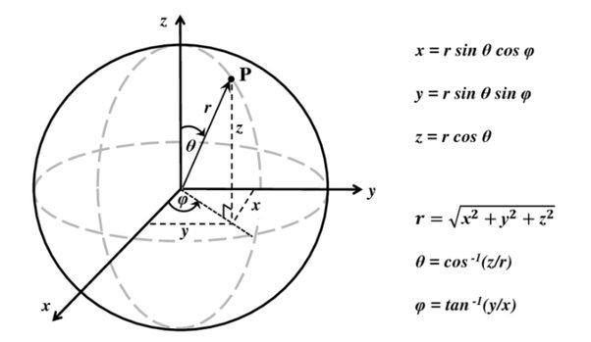

Slide 13
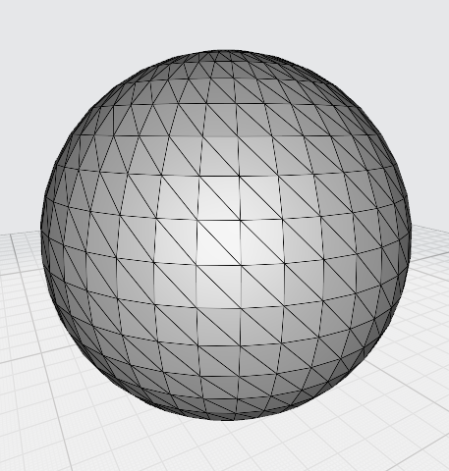
3. Different objects generation
2. Word count problem done

Slide 14

Thank you

